Slide 1
MSBD 5013 Project 2
M5 Uncertainty
WU Hao (20787513) GUO Lingjun (20786416) ZHOU Yuhan (20787032)
Group 5

Slide 2
01
Introduction
Content
02
Dataset
03
Model
04
Evaluation
05
Comparison
06
Conclusion

Slide 3
Introduction
/01

Slide 4

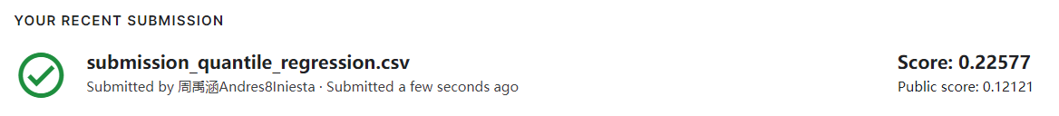
Introduction
Problem
In the M5 Uncertainty project, the main problem is to estimate the uncertainty distribution of Walmart unit sales. We need to predict 9 quartile of item sales in different stores across various locations for two 28-day periods of uncertainty forecasting with the corresponding median and 50%, 67%, 95%, and 99% prediction intervals.
Models we implemented
Quantile Regression with Keras
LGBM, LSTM and SES
Considering the Algorithmic logic and overall performance, we chose Quantile Regression with Keras as the winning model.

Slide 5
Dataset
/02

Slide 6
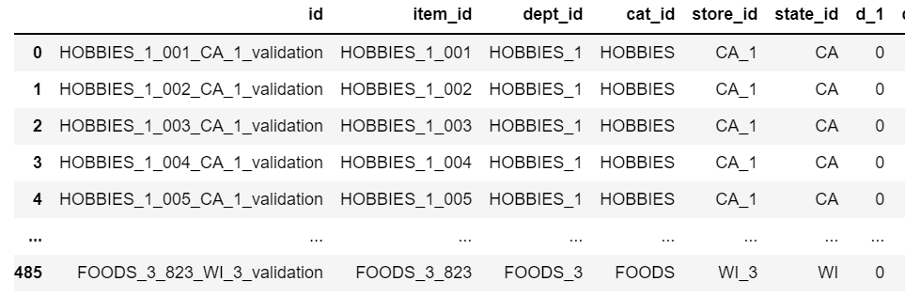
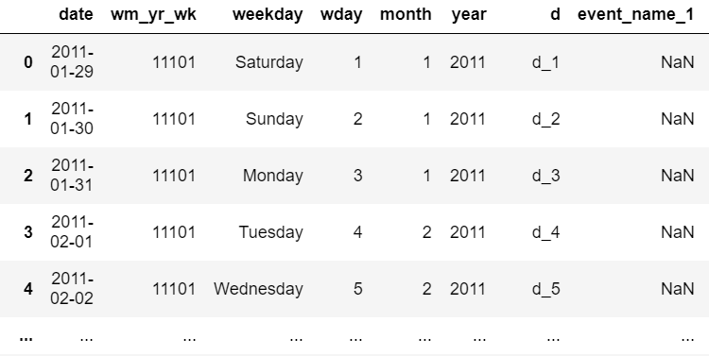
Dataset
Sales: Consist of previous 1941 days (starting from 2011-1-29). The sales data has columns for the ids of items(3049), departments(7), categories(3), stores(10) and states(3).
Calendar: Gives information about dates and events. The date starts from 01-29-2011 and ends on 19-06-2016 which tells that the data ranges for 5 years and 5 months.
Data Pre-processing
The given dataset is extremely wide which has 1941 day features. So we reshaped the data, preprocessed the calendar, kept the features and dates we need, then melted it to a long data frame. Besides, we applied memory reduction which reduced 78.4% of the memory usage for all the given data sets

Slide 7
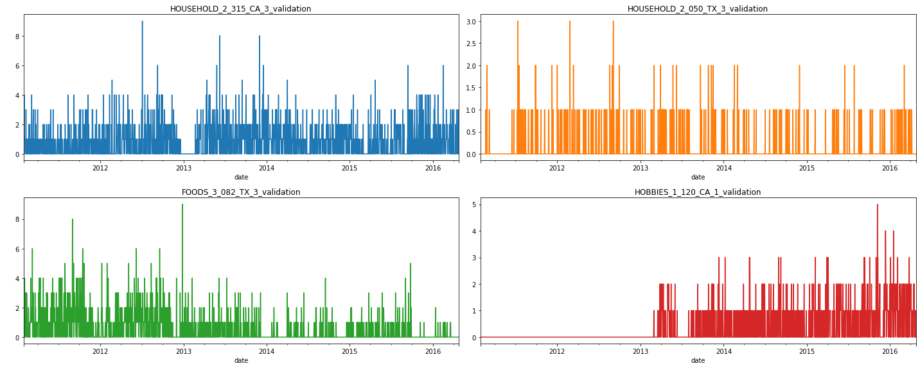
Exploratory Data Analysis
Visualize random four different items to see their sales over time.

Slide 8
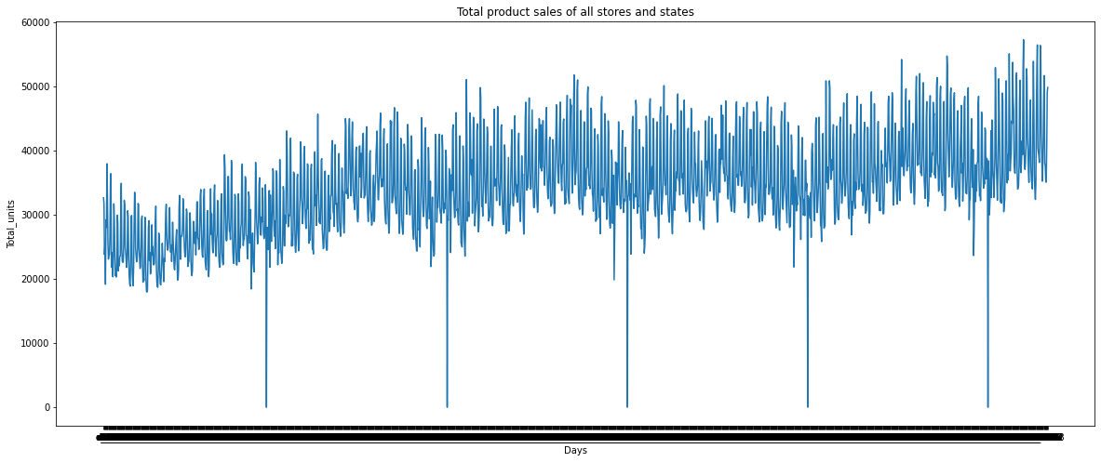
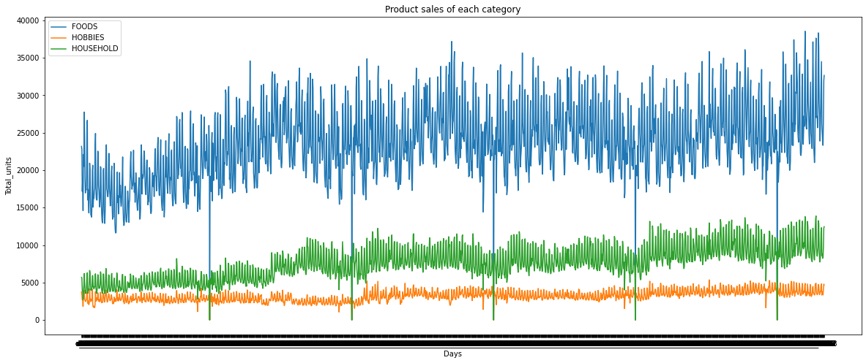
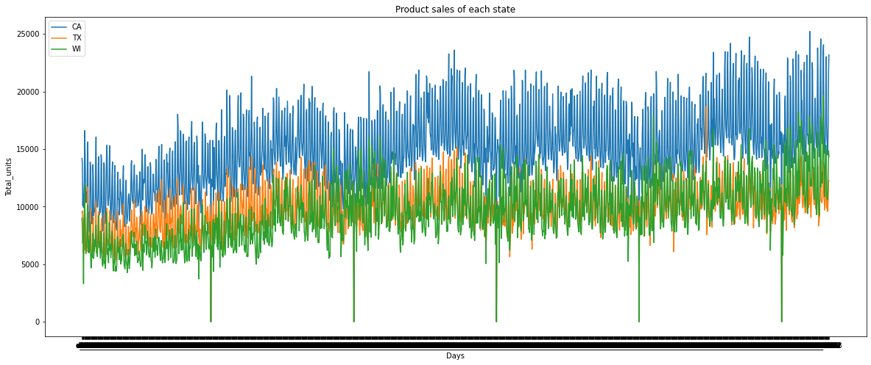
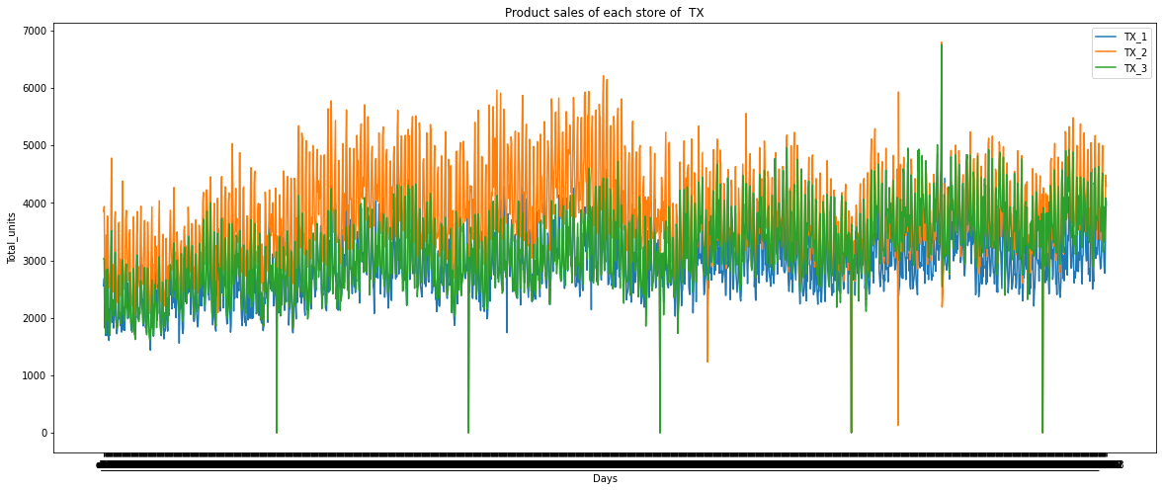
Exploratory Data Analysis
Find the relationship between time and total item sold aggregated by States, store, category and department. We can see the overall sales follows a nice periodic pattern.

Slide 9
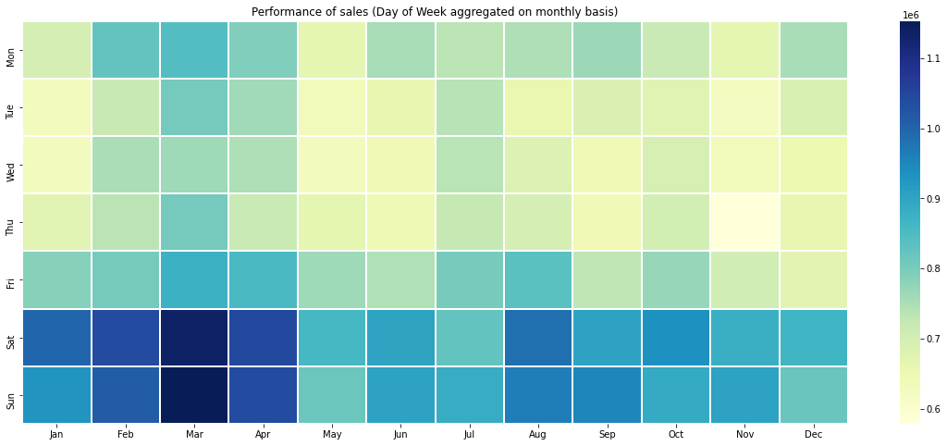
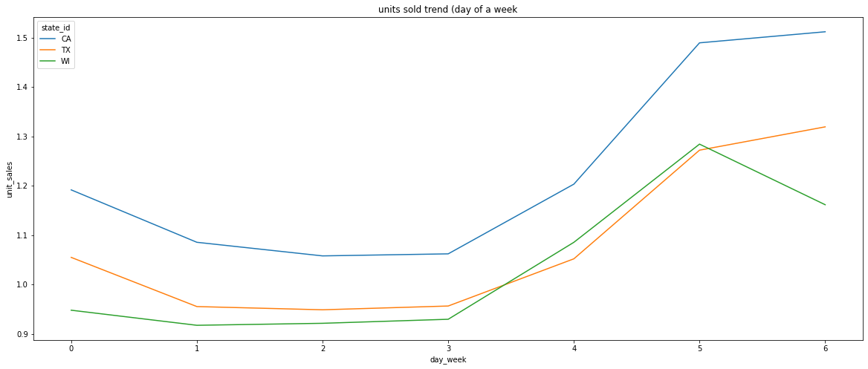
Exploratory Data Analysis
Gather more information on Weekly and monthly seasonality
The sales on saturday and sunday (Weekends) are much higher than other days.
The highest sales appeared in Feb, March and April weekends.The 5th month has the lowest sales and the 8th month got the highest sales.

Slide 10
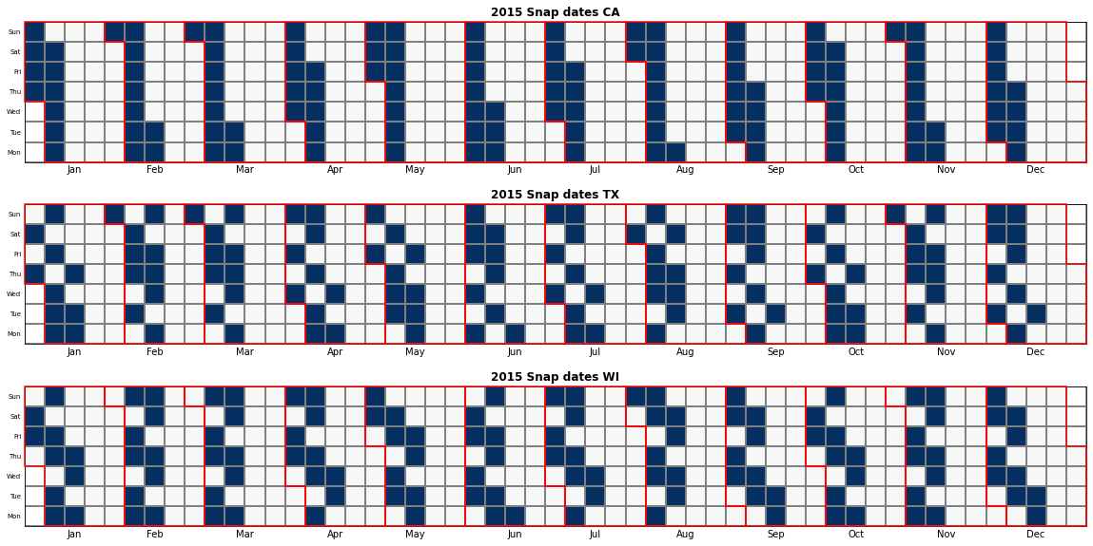
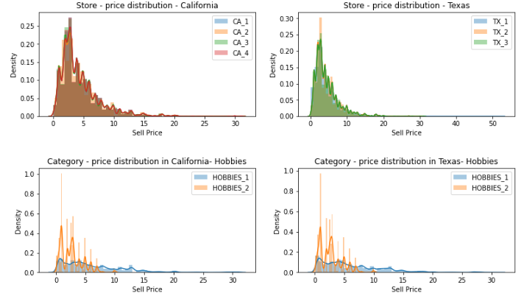
Exploratory Data Analysis
Explore the relationship between calendar events and sales.
Summary of EDA
Understanding the given dataset.
Actually taking a look at the time series irregularity of all of the sales.
Analyzing the trends of aggregate sales of time series.
From calendar, checked how events are related to the sales.
Weekends have more sales.
All three different regions almost have the same prices of products.
Checked the variation with respect to SNAP days with the sales aggregation.

Slide 11
Model: Quantile Regression with Keras
/03

Slide 12
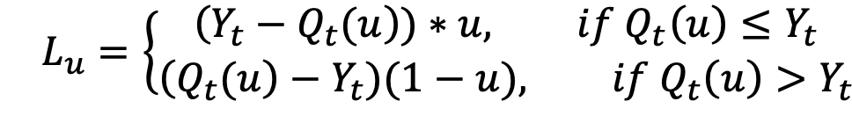
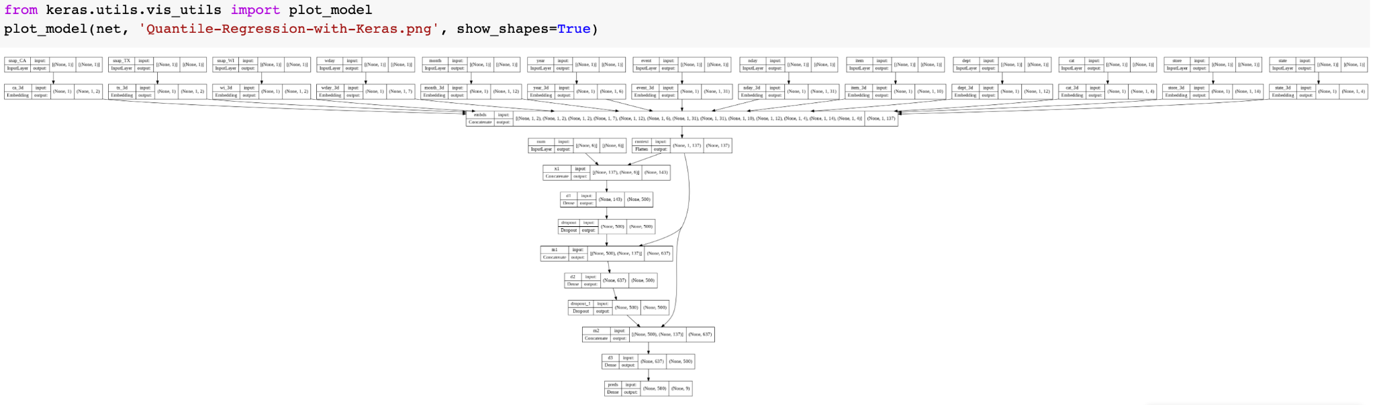
Quantile Regression with Keras
Pinball Loss Function
Network Structure Diagram
Notes:
When we are doing the quantile regression, we apply this pinball loss function on our multiple quantiles given by the competition. Instead of the single value prediction, the quantile regression loss function allows us to consider the potential prediction error. Here in the equation, the loss L_u is computed using the quantile u, the generated forecast Q_t (u), and the actual future value Y_t. Then, with this loss function, we use Tensorflow and Keras to build our quantile model. We draw our network structure diagram using keras, and as it shows in this plot, our model has a lot of layers because we include a lot of features. The detailed diagram can be found with our code in the uploaded notebook.

Slide 13
Evaluation
/04

Slide 14
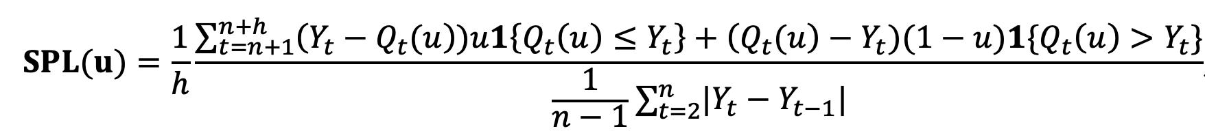
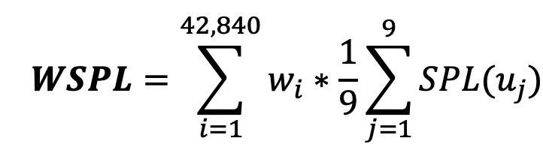
Evaluation
u is set to u₁ = 0.005, u₂ = 0.025, u₃ = 0.165, u₄ = 0.25, u₅ = 0.5, u₆ = 0.75, u₇ = 0.835, u₈ = 0.975, and u₉ = 0.995.
Notes:
According to the rules of the Kaggle competition, we apply Scaled Pinball Loss (SPL) function for each time series and for each quantile to evaluate precision of the probabilistic. Other notations are the same as in the previous slide, except h here represents the forecasting horizon. The denominator of SPL is computed only for the time-periods following the first non-zero demand observed for the series under evaluation. u will be set to these values, and then after calculating the SPL for all the 42,840 time series and all the requested quantiles, the final scores in the competition are ranked using the Weighted SPL (WSPL) where w_i is the weight of the i_th series of the competition. A lower WSPL score means the model is better.

Slide 15
Comparison
/05

Slide 16
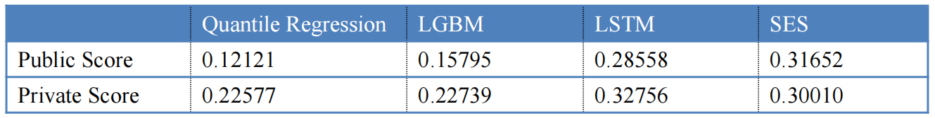
Comparison with other models
In addition to the Quantile Regression Model, we also try some other models including LGBM, LSTM and SES.
Since we have done the former “Accuracy” project with these models, The results could be generated from those submission files.
By considering the quantiles distribution as a cumulative normal distribution.
These models also have good performances on uncertainty

Slide 17
Conclusion
/06

Slide 18
Conclusion
This project is another research aspect of Walmart sales prediction
To optimize the uncertainty or stability of the prediction
We built up several models and tried different methods to improve the stability
Another standard to measure the performance of a prediction
Future Work
Concentrate more on neural network (CNN & RNN) to optimize not only the accuracy but also the stability of sales prediction.

Slide 19
Thanks!

